Slide 1
MALATTIA DA REFLUSSO GASTROESOFAGEO ED ERNIA IATALE NEL PAZIENTE CON OBESITÀ LA DIAGNOSI PRE-OPERATORIA
Antonella santonicola
Gastroenterologia
Dipartimento di Medicina, Chirurgia ed Odontoiatria
Università degli studi di Salerno

Slide 2
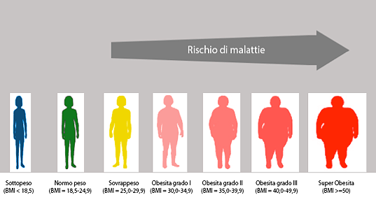
GERD
La prevalenza dei sintomi da GERD tra i pazienti candidati alla chirurgia bariatrica è compresa tra il 40.8% e il 62.4%
Maleckas A. et al 2024

Slide 3


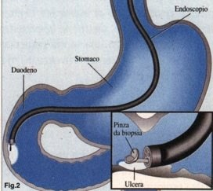
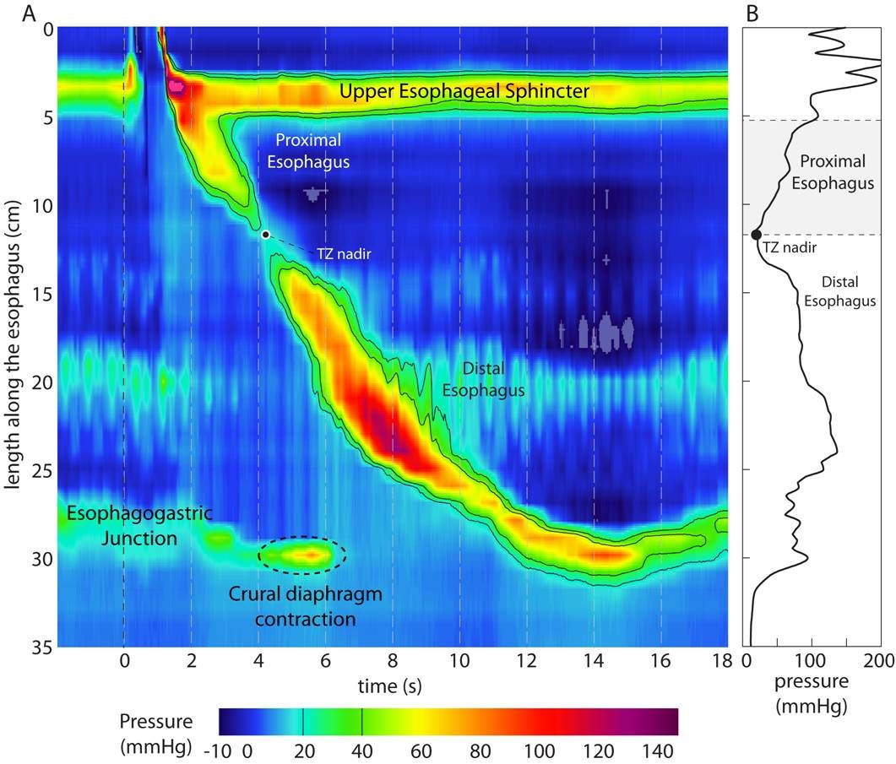
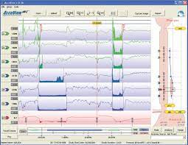
INQUADRAMENTO DIAGNOSTICO-FUNZIONALE DEL PAZIENTE CANDIDATO A CHIRURGIA BARIATRICA

Slide 4
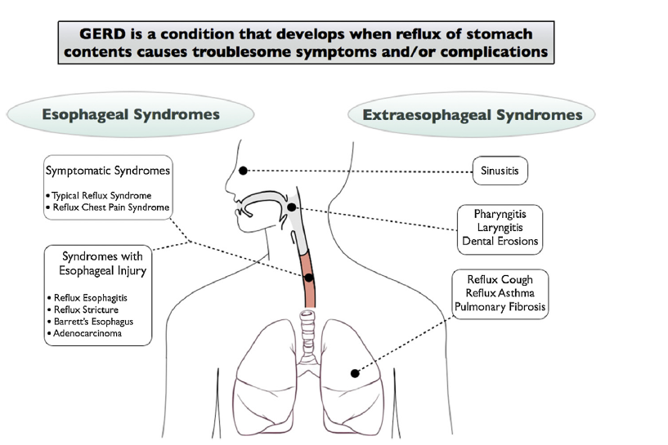

GERD - Montreal Consensus
Vakil N. and the Global Consensus Group. Am J Gastroenterol 2006

Slide 5

DIAGNOSTIC PITTFALLS
Expert history by a gastroenterologist
- 70% sensitivity
- 67% specificity
(when compared with objective evidence of GERD defined by pH-metry)
GERD questionnaires: accuracy less than 70%
MONTREAL CONSENSUS
Ghisa M. et al.Neurogastroenterol Motil. 2020

Slide 6
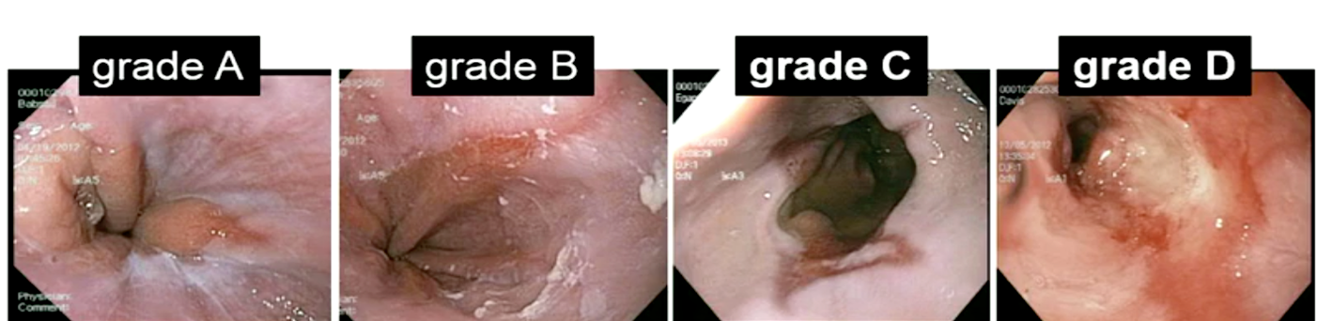
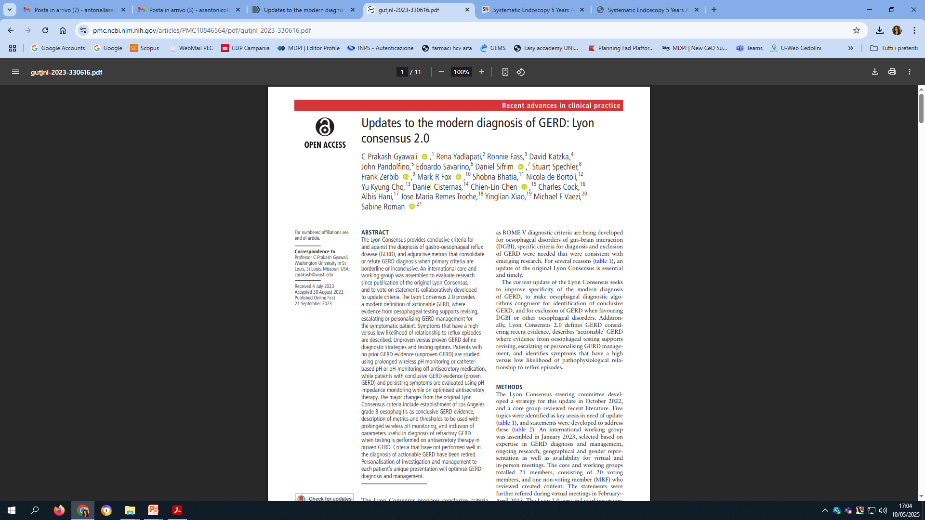
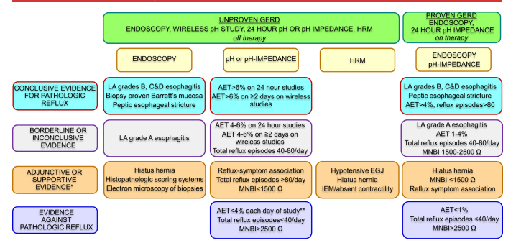
GERD DIAGNOSIS
Gut 2023

Slide 7
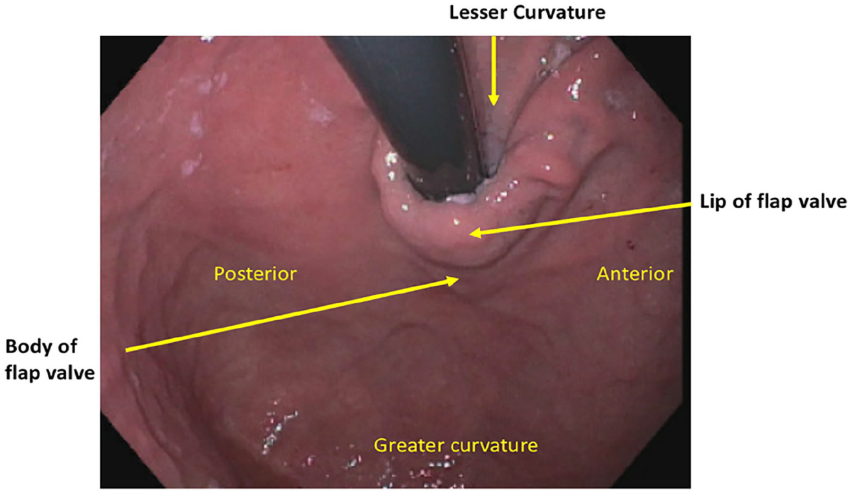
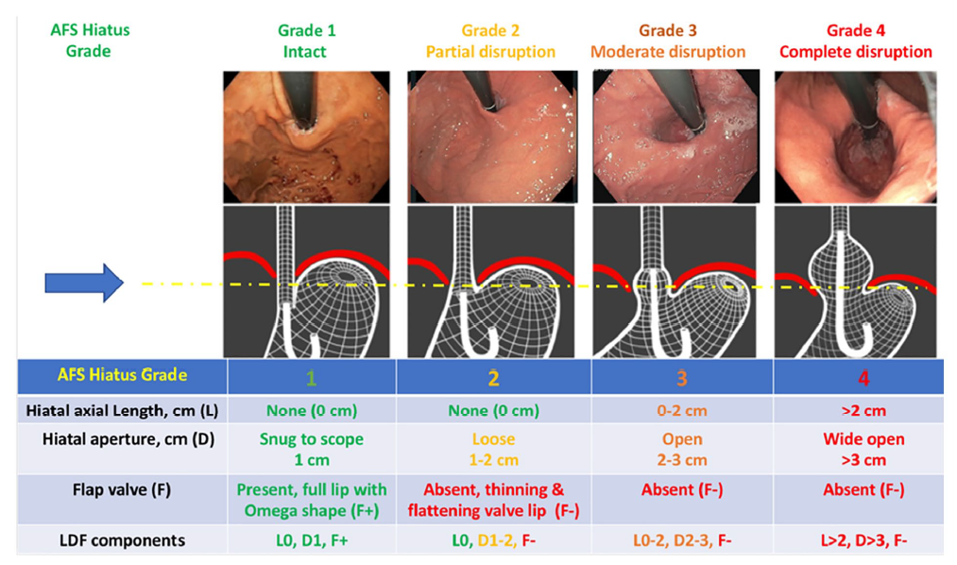
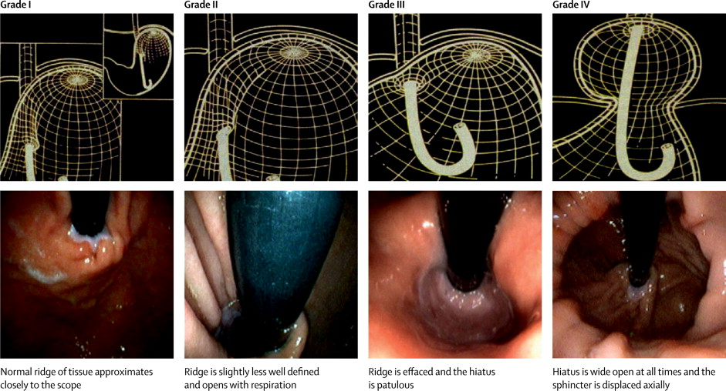
Diagnosi di ernia iatale vs. stratificazione rischio MRGE
EGDS
Hill vs. AFS classification
Nguyen et al. The American Foregut Society White Paper on the Endoscopic Classification of Esophagogastric Junction Integrity, Foregut 2022
Notes:
The American Foregut Society (AFS) developed a new endoscopic classification system focused on 3 components: axial length of hiatal hernia (L component), wideness of hiatal opening (D component) and presence of the flap valve (F component)

Slide 8

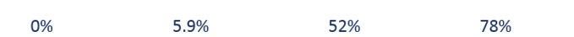
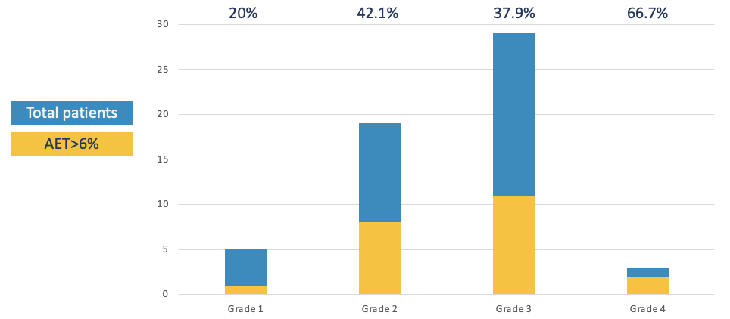
Diagnosi di ernia iatale vs. stratificazione rischio MRGE
EGDS
Hill vs. AFS classification
Hill classification
p=0.411
Siboni S, Sozzi M, Kersik A, Lovece A, Milito P, Menikou F, Bonavina L, Froiio C, Bernardi D, Asti E, Foregut 2024

Slide 9
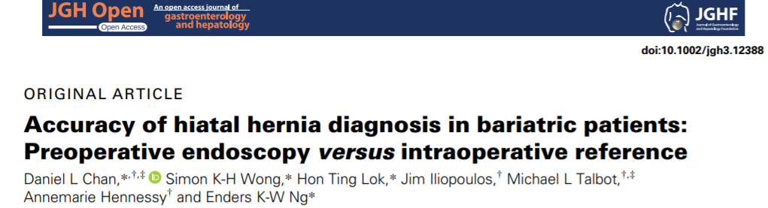

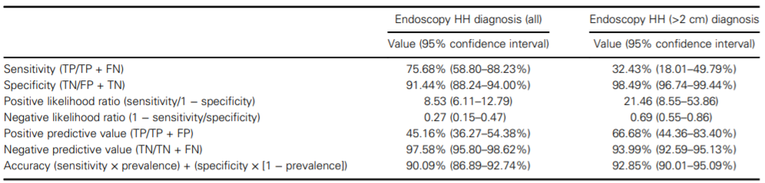
Study type: retrospective analysis
Endpoint: Endoscopy results were compared to intraoperative findings, and subgroup analysis of >2 cm hernias was performed.
Conclusions: Endoscopy can achieve an accuracy comparable to HRM in high-volume endoscopy centers.
JGH Open. 2020

Slide 10
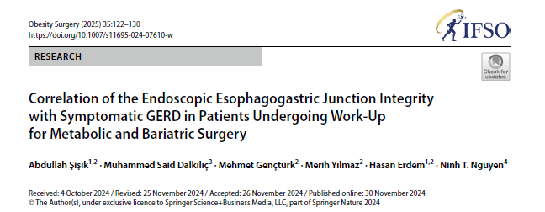

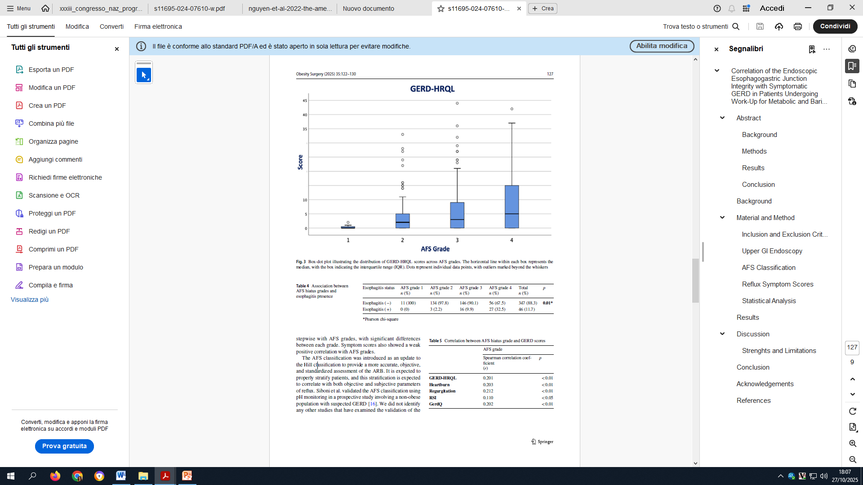

AFS grade shows a positive but weak correlation with GERD-HRQL, GerdQ, and RSI reflux symptom scores.
Esophagitis rates increased stepwise with AFS hiatus grades, with significant differences between each grade.
This study supports the practical utility of the AFS classification.

Slide 11
GERD DIAGNOSIS
Gut 2023

Slide 12
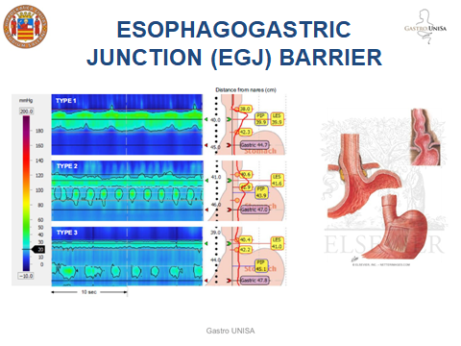
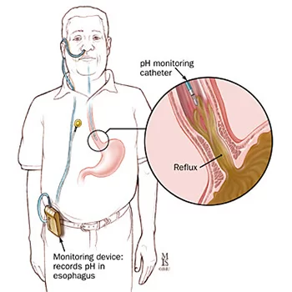
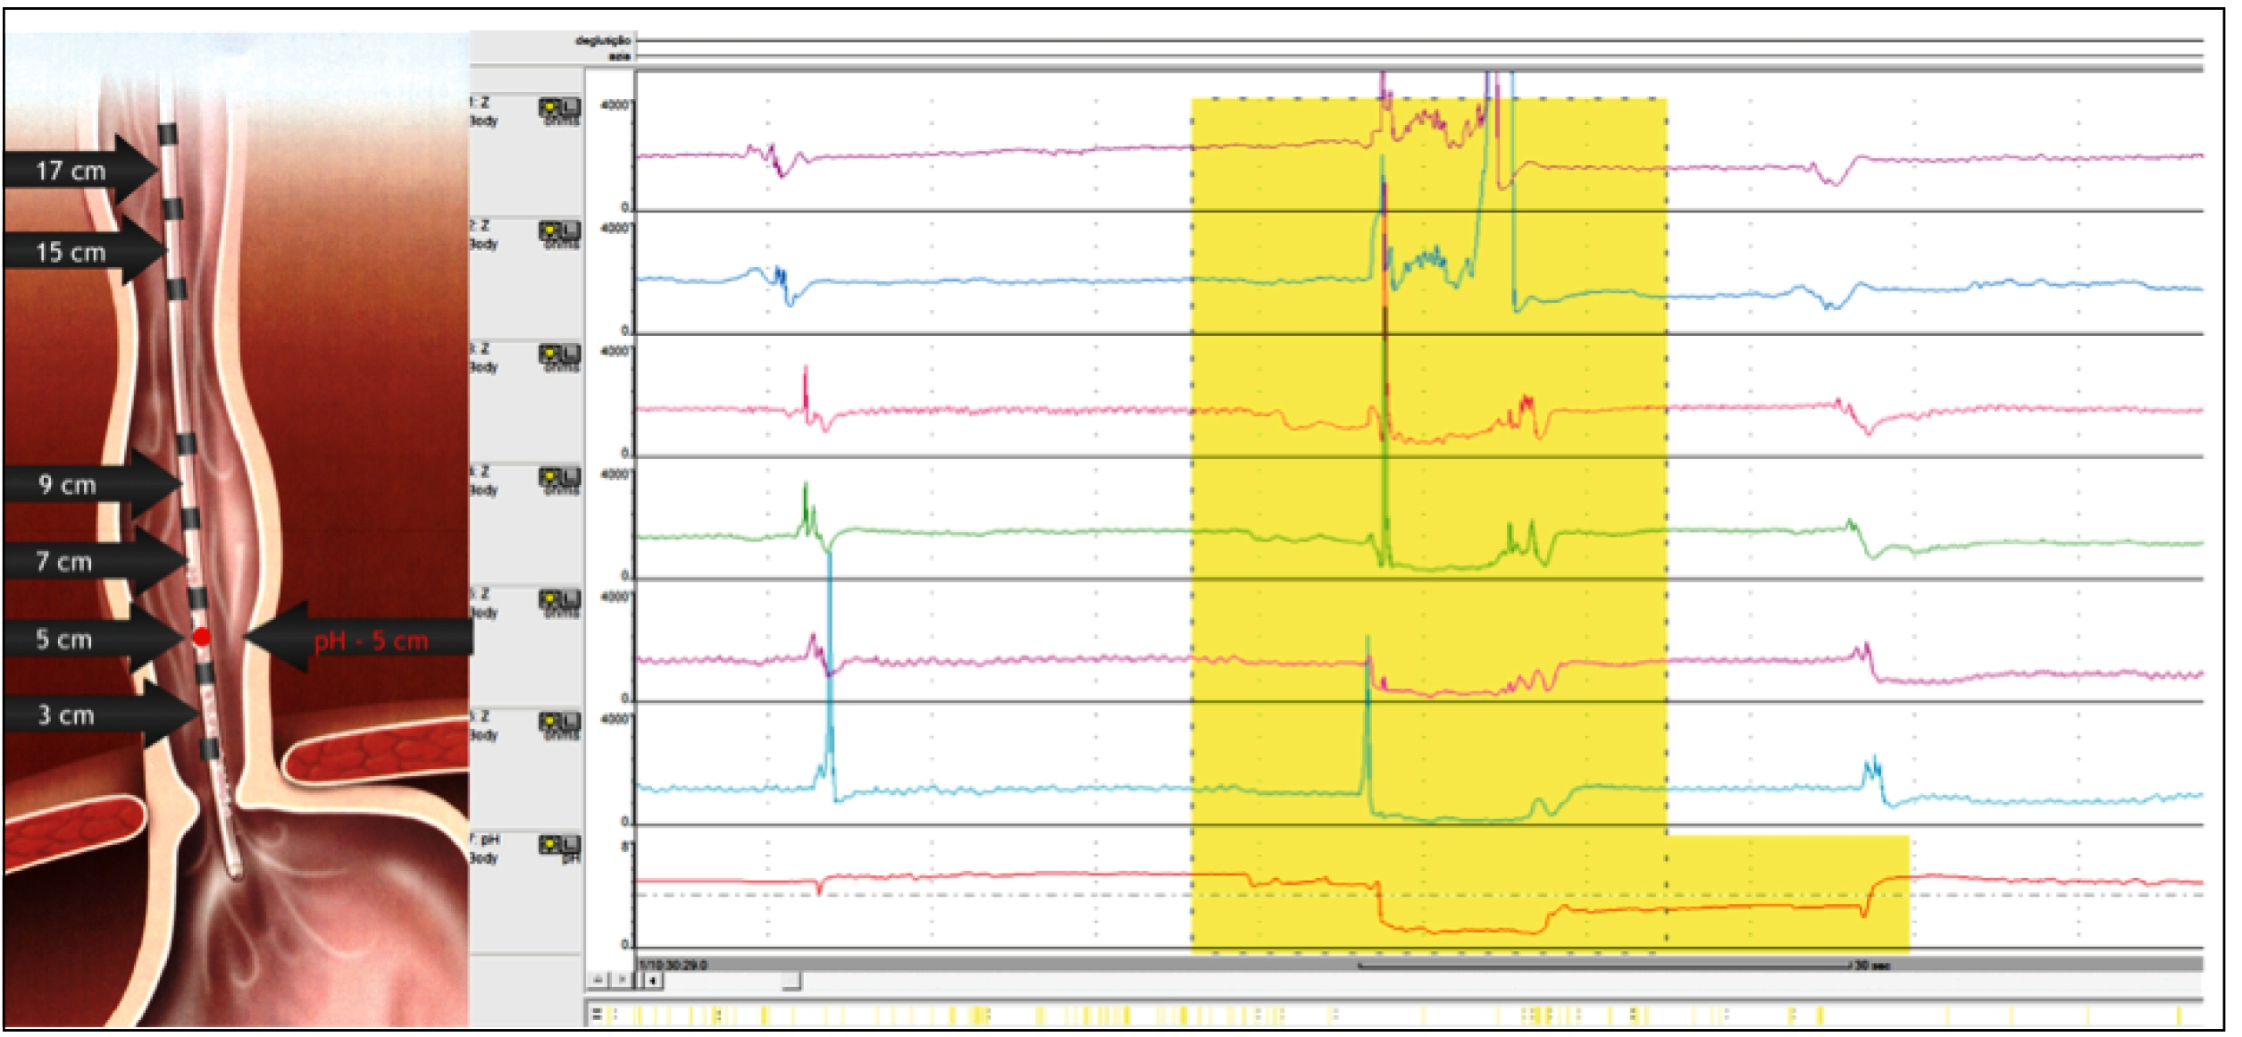
High Resolution Manometry and 24h pH impedance monitoring
Esophagogastric Junction (EGJ)
Acid exposure time (AET)
Total reflux episodes/MNBI
Esophageal Motility

Slide 13
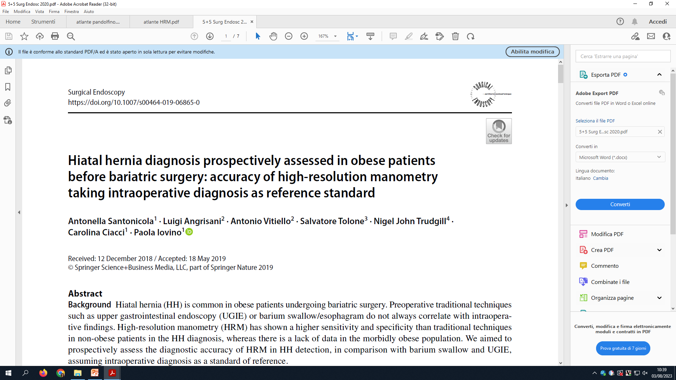
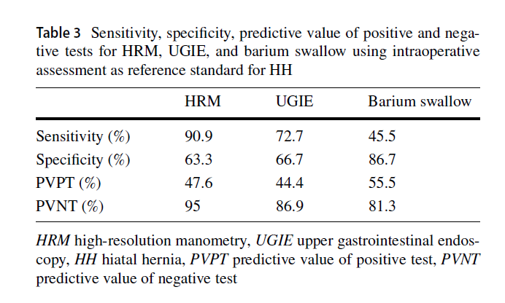
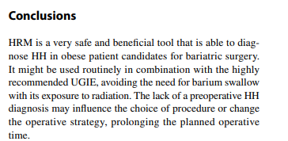
41 consecutive morbidly obese patients underwent GERD questionnaires, barium swallow, UGIE, and HRM before bariatric surgery.
The intraoperative diagnosis of HH was considered the reference standard. All the surgical procedures were performed by a single surgeon who was blinded to UGIE, HRM, and barium.
HH was intraoperatively diagnosed in 11/41 patients
The combination of UGIE together with HRM reached a sensitivity of 100%.
Santonicola et al. Surgical Endoscopy 2019

Slide 14
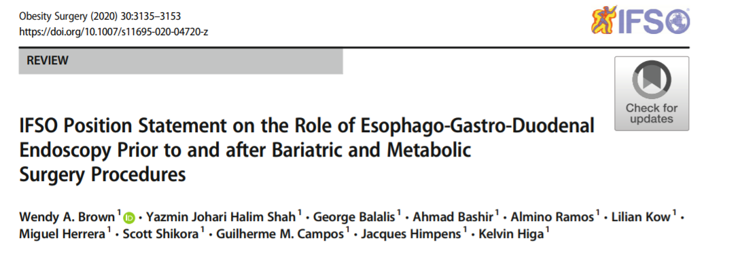

EGD should be considered for all patients with upper GI symptoms planning to undergo a bariatric procedure due to the frequency of pathology that may alter management.
EGD should be considered for patients without upper GI symptoms who are planning to undergo a bariatric procedure due to the 25.3% chance of an unexpected finding that may alter management or contra-indicate surgery.
EGD should be routinely considered in populations where the community incidence of significant gastric and esophageal pathology is high, particularly when the procedure will lead to part of the stomach being inaccessible (for example RYGB and OAGB).

Slide 15

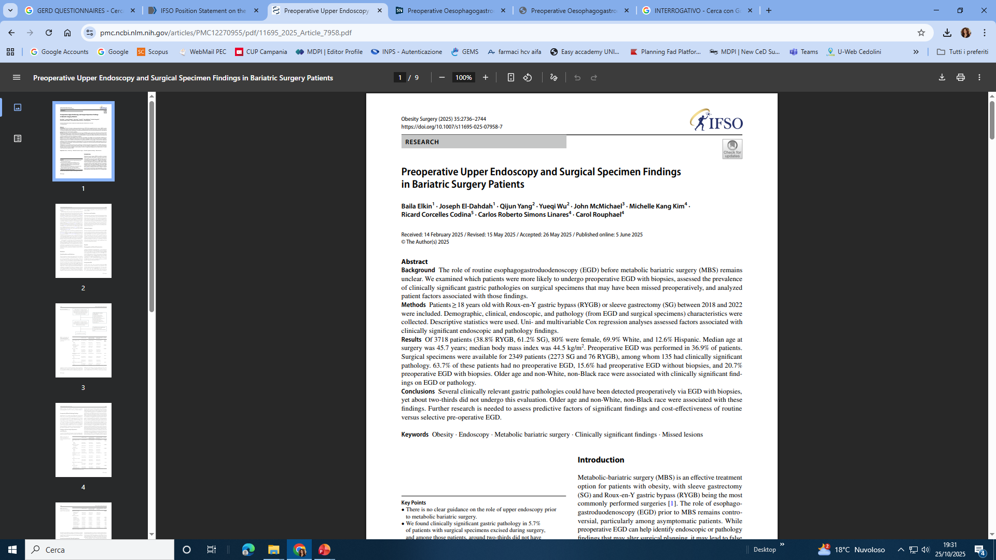
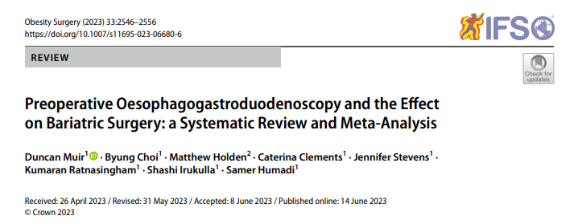
3718 patients
63.7% no preoperative EGD,
15.6% preoperative EGD without biopsies
20.7% preoperative EGD with biopsies.
23,368 patients
47 studies included in the review
40.8% no novel findings,
39.7% novel findings which did not affect surgical planning,
19.8% findings affecting surgical planning
0.3% were ruled to not be suitable for bariatric surgery
Despite preoperative OGDs being recommended in all
patients due to undergo bariatric surgery (in Europe), they are only changing management in roughly one-fifth of all patients.

Slide 16
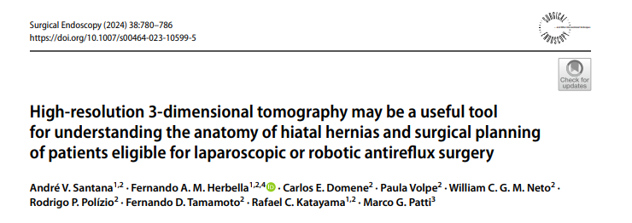
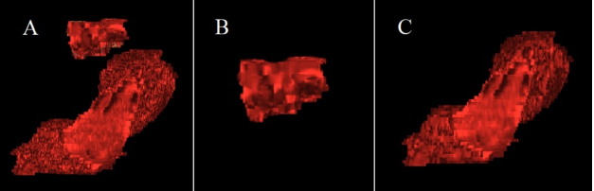
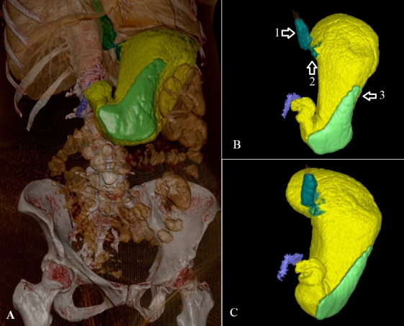
There was correlation between tomographic and endoscopic findings for the presence (p=0.005) and size of HH (p=0.0002).
There was no correlation between tomographic and manometric findings for the diagnosis of HH (p=0.1).
There was no correlation between hiatal area and lower esophageal sphincter basal pressure (p=0.08).
There was no correlation between the herniated gastric volume (p=0.6), distance EGJ-hiatus (p=0.6), total gastric volume (p=0.9), and hiatal area (p=0.6) with the DeMeester score.

Slide 17
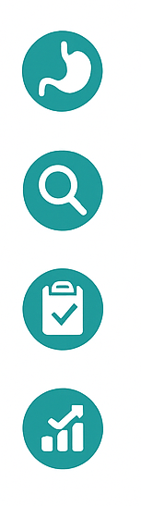
CONCLUSIONI
La malattia da reflusso e l’ernia iatale sono frequenti nei candidati a chirurgia bariatrica (≈40–60%).
La sola valutazione clinica (sui sintomi) non è affidabile → necessaria una diagnostica oggettiva.
L’EGDS preoperatoria è raccomandata in tutti i pazienti, anche asintomatici
La combinazione di EGDS e manometria ad alta risoluzione (HRM) migliora l’accuratezza diagnostica e la pianificazione chirurgica

Slide 18

TAKE HOME MESSAGES
L’approccio deve essere multimodale e personalizzato.
È essenziale una collaborazione gastroenterologo–chirurgo nella fase preoperatoria.
La corretta diagnosi di ernia iatale e disfunzione EGJ è cruciale per la scelta della corretta tecnica chirurgica
Prospettiva futura: standardizzare un algoritmo diagnostico pre-operatorio condiviso per il paziente con reflusso candidato a chirurgia bariatrica.

Slide 19
Grazie

